Slide 1

A guide to using our PowerPoint template

Slide 2
This guide contains information and instructions on how-to use our PowerPoint template to its full potential

Slide 3


How many templates are there?
Four templates
Available for both VCU Health and VCU Health Community Memorial Hospital
Each is available with white or dark background

Slide 4
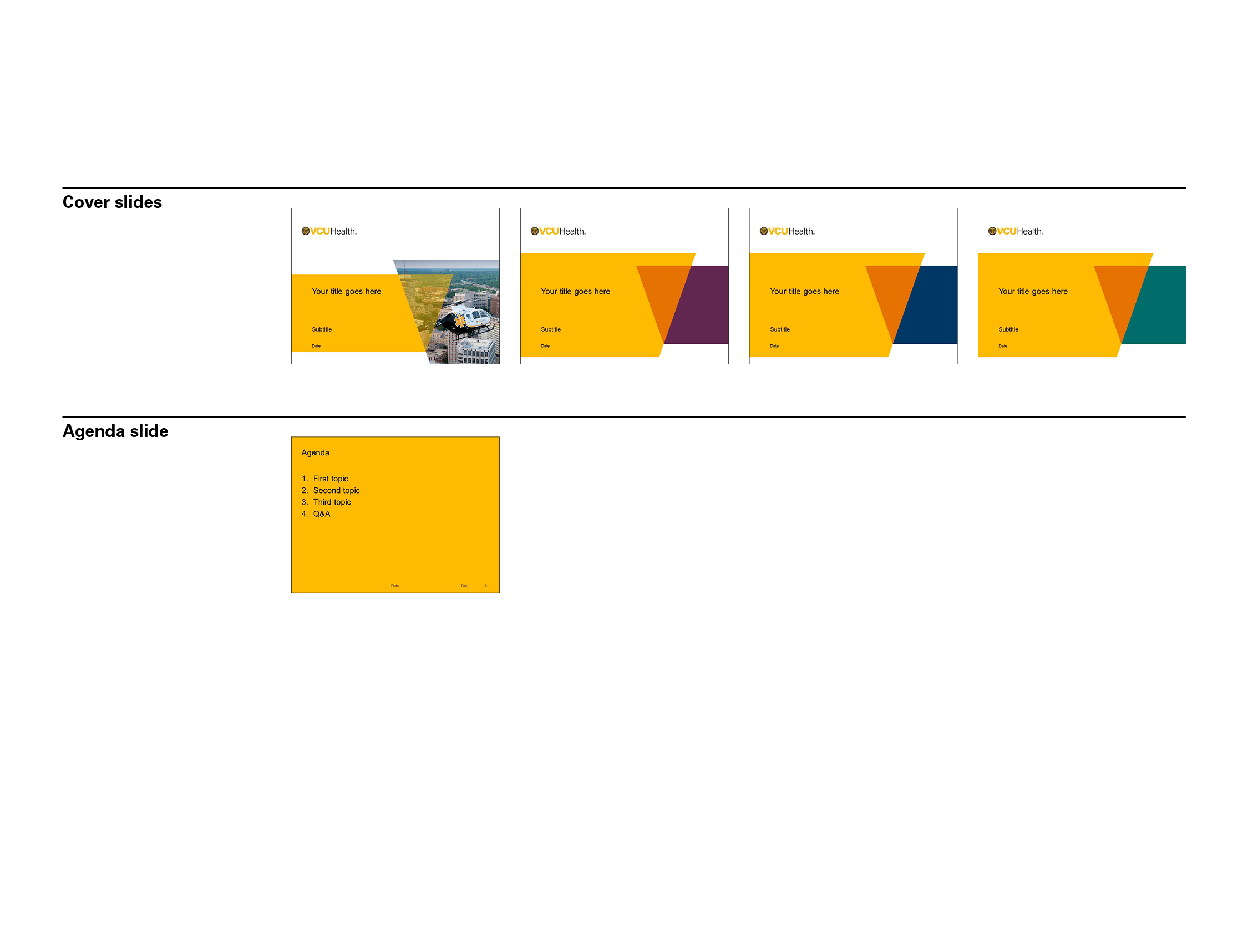
What kind of slide layouts are available?

Slide 5
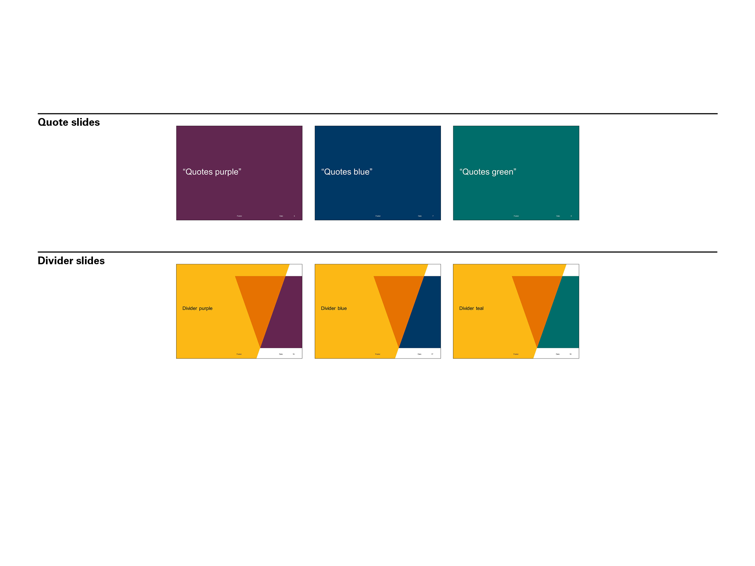
What kind of slide layouts are available (cont.)?

Slide 6
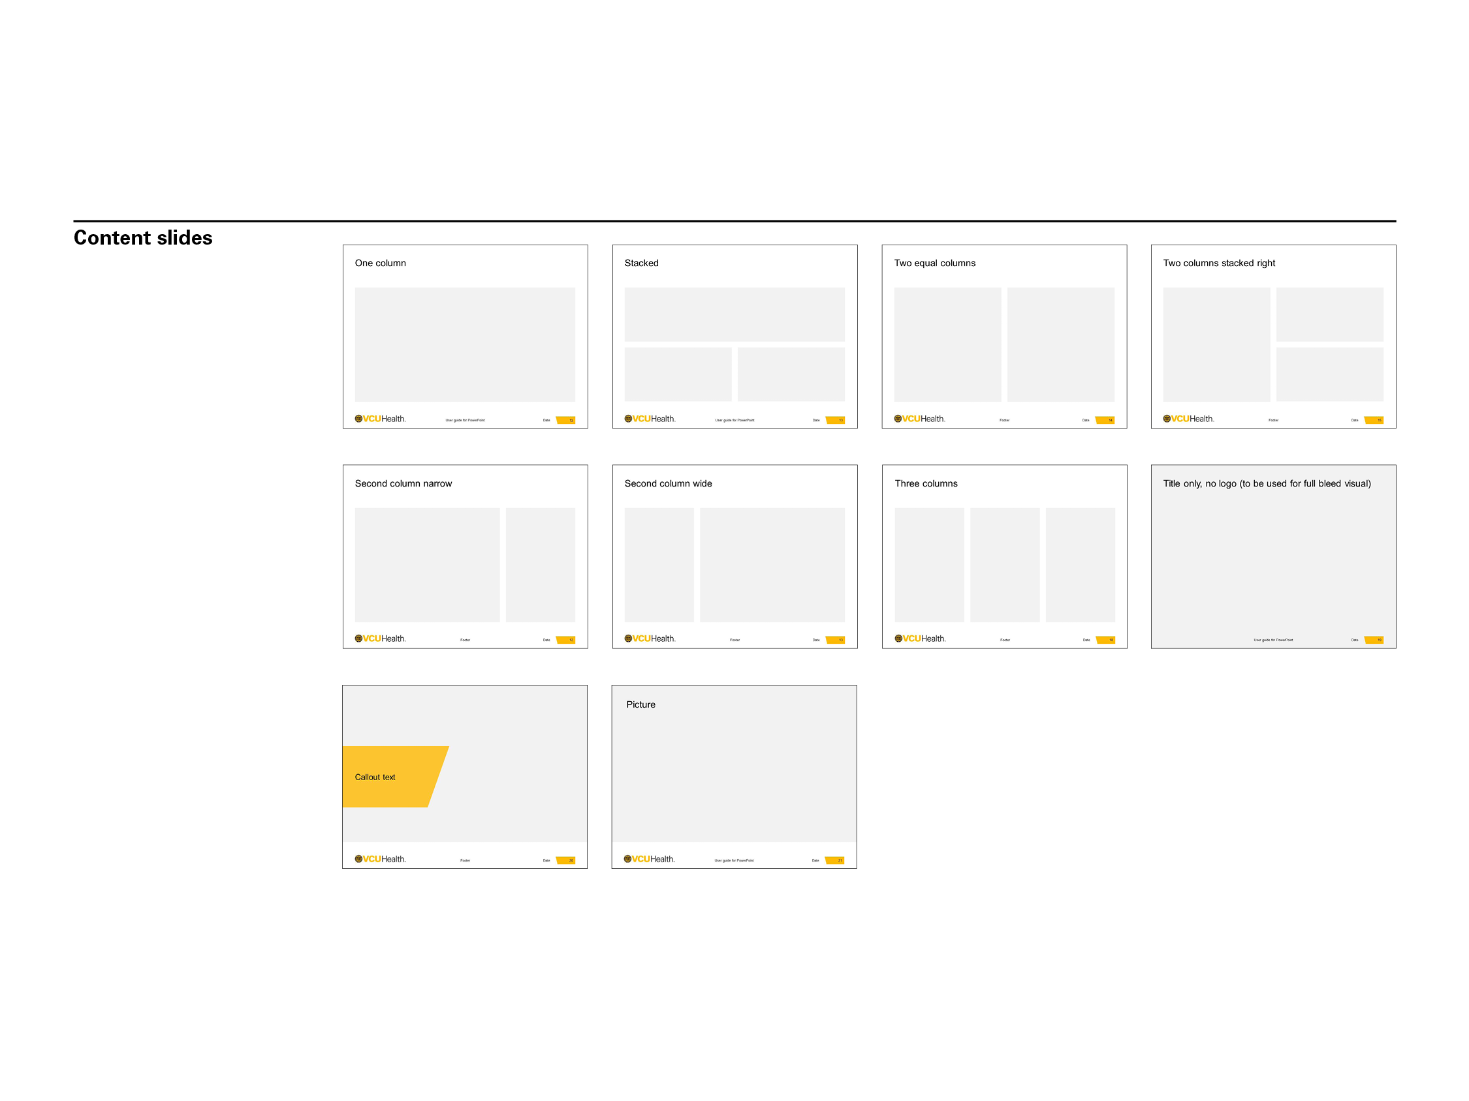
What kind of slide layouts are available (cont.)?

Slide 7
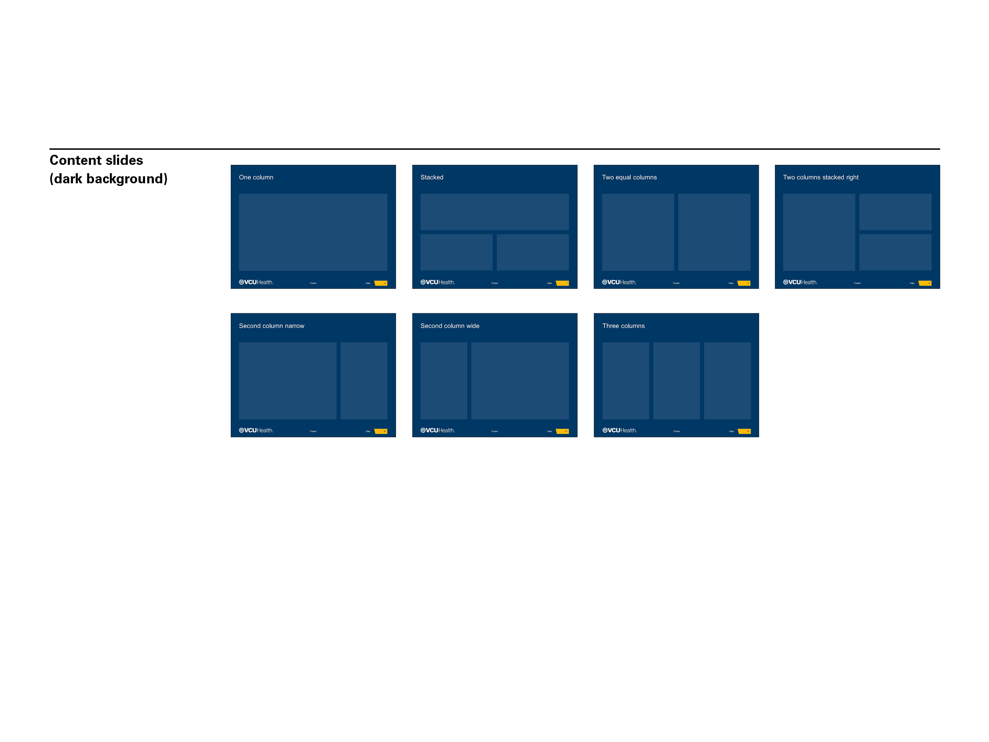
What kind of slide layouts are available (cont.)?

Slide 8
Our content slides are organized in columns

Slide 9
And rows

Slide 10
Combined, the columns and rows create the grid

Slide 11
Your static guides should match this page

Slide 12
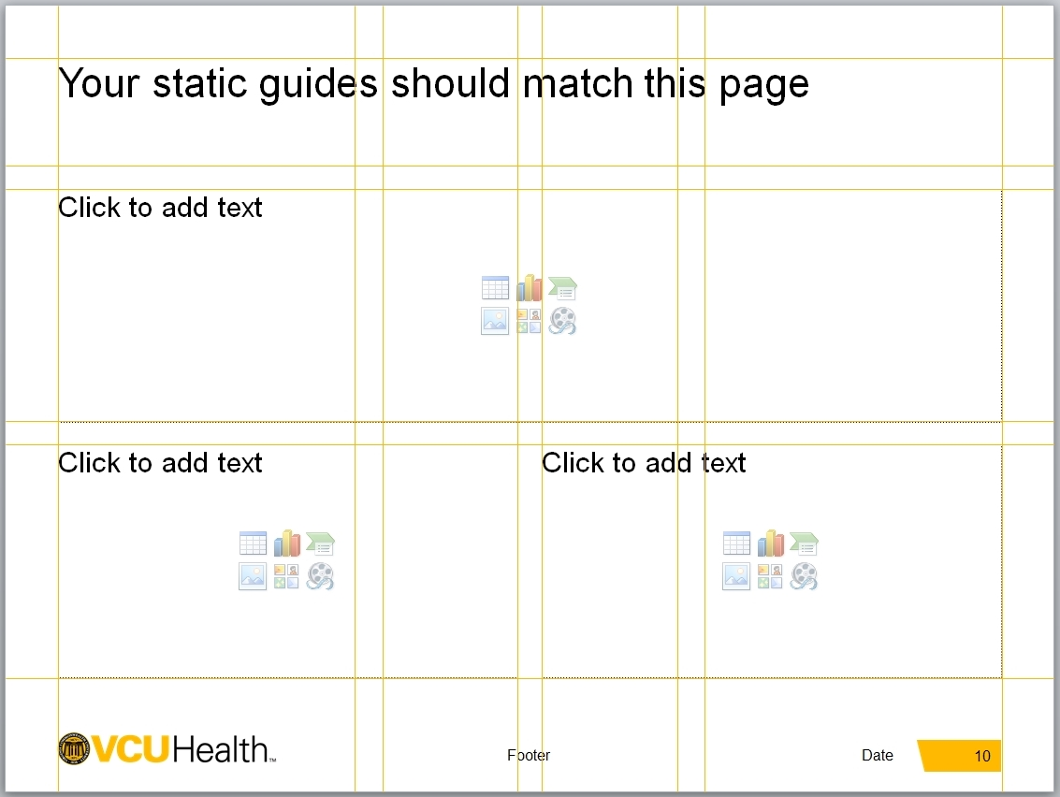
Guideline Slide
The preceding slide appears as the last master slide in the PowerPoint template.
Insert it temporarily into your presentation to reposition the guides to their original position should that become necessary.

Slide 13
Your content should fit within the designated margins
Full bleed image slides are the obvious exception to this rule
All other slides should fit within this framework so that our logo and your slide title remain unobstructed and fully-legible
Text boxes have no “internal” margins

Slide 14
For example in two-columns
Text, chart or image here
Text, chart or image here

Slide 15
Stacked
Text, chart or image here
Text, chart or image here
Text, chart or image here

Slide 16
Narrow and Wide Column
Text, chart or image here
Text, chart or image here. This is a great layout for combining text and image

Slide 17
Three columns
Text, chart or image here
Text, chart or image here
Text, chart or image here

Slide 18
Two columns stacked right
Text, chart or image here
Text, chart or image here
Text, chart or image here

Slide 19
Overview of basic functionality

Slide 20
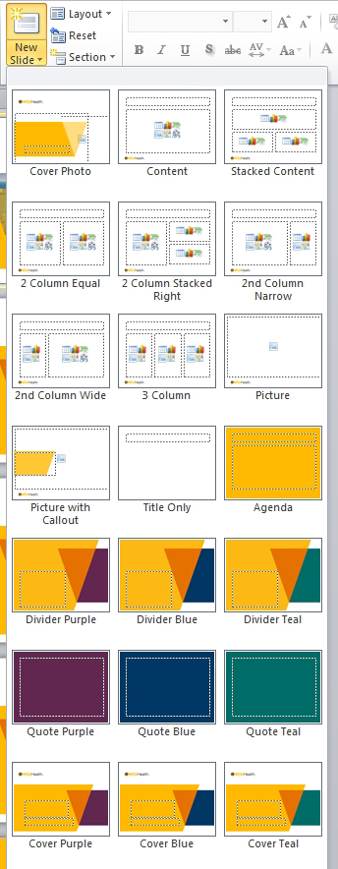
Inserting New Slides
Home Tab > Insert > click ‘New Slide’
A slide will be added of the same layout type as the currently selected slide
OR
Home Tab > Insert > click and hold ‘New Slide’
Choose the layout you want to insert from the drop down menu

Slide 21
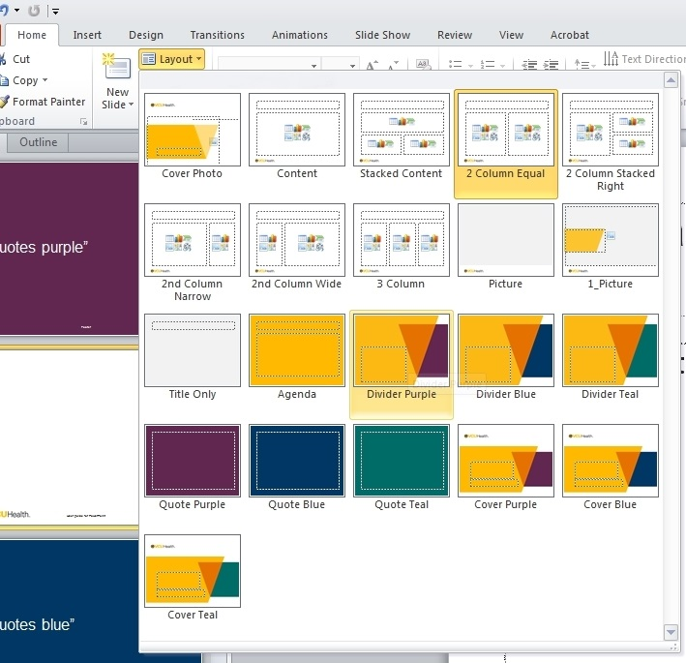
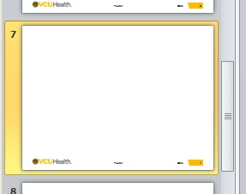
Changing a Slide to a Different Layout
In the Document Pane, click to select the slide you want to change (the selected slide will have a yellow outline)
Home Tab > Layout
Select from the drop down menu the layout you want to apply

Slide 22
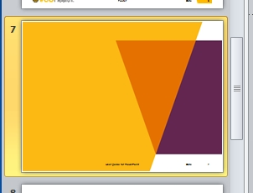
Changing Slide to a Different Layout (cont.)
The selected slide will now use the desired layout

Slide 23
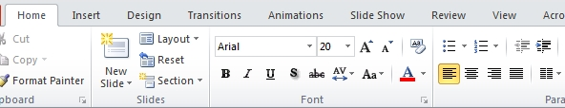
Increasing/Decreasing Font Size
Standard type size is 20pt. Our preference is to maintain this standard size and add pages as needed.
If needed, use the buttons on the Home Tab to increase or decrease the font size.

Slide 24
Indenting Text and Bullets
Do not add bullets by clicking the bullet icon. Instead, use the ‘Paragraph Indent’ buttons in the ‘Home’ tab to toggle between different indent levels.

Slide 25
Indenting Text and Bullets
There are a total of 6 indent levels in addition to the standard paragraph.
This is the first level of indentation at type size of 20pt.
This is the second level of indentation at type size of 16pt.
This is the third level of indentation at type size of 16pt.
This is the fourth level of indentation at type size of 16pt.
This is the fifth level of indentation at type size of 14pt.
This is the sixth level of indentation at type size of 14pt.

Slide 26
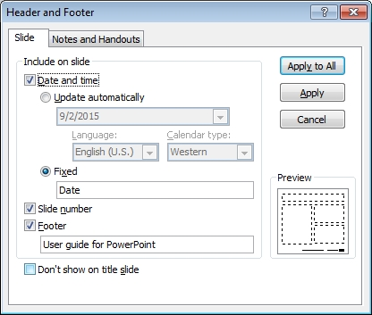
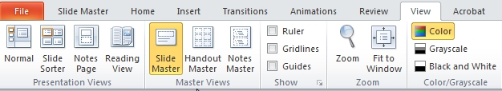
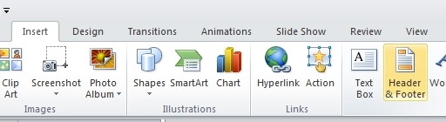
Header and Footers
View Tab > Slide Master
Insert Tab > Header and Footer
Customize options for ‘Date and Time’, ‘Slide Number’ and ‘Footer’ as needed
Click ‘Apply to All’
View Tab > Normal to exit the Slide Master View

Slide 27
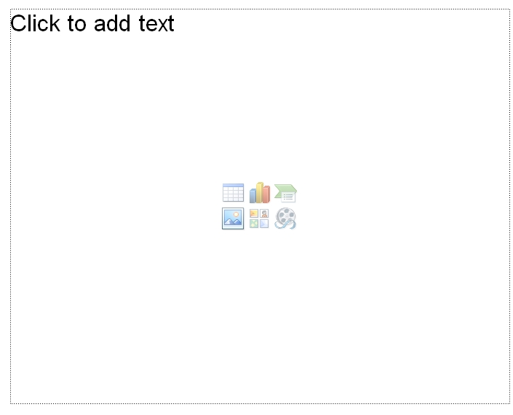
Inserting Images
Click on the ‘Insert Picture from File’ icon of a content box to insert an image.

Slide 28
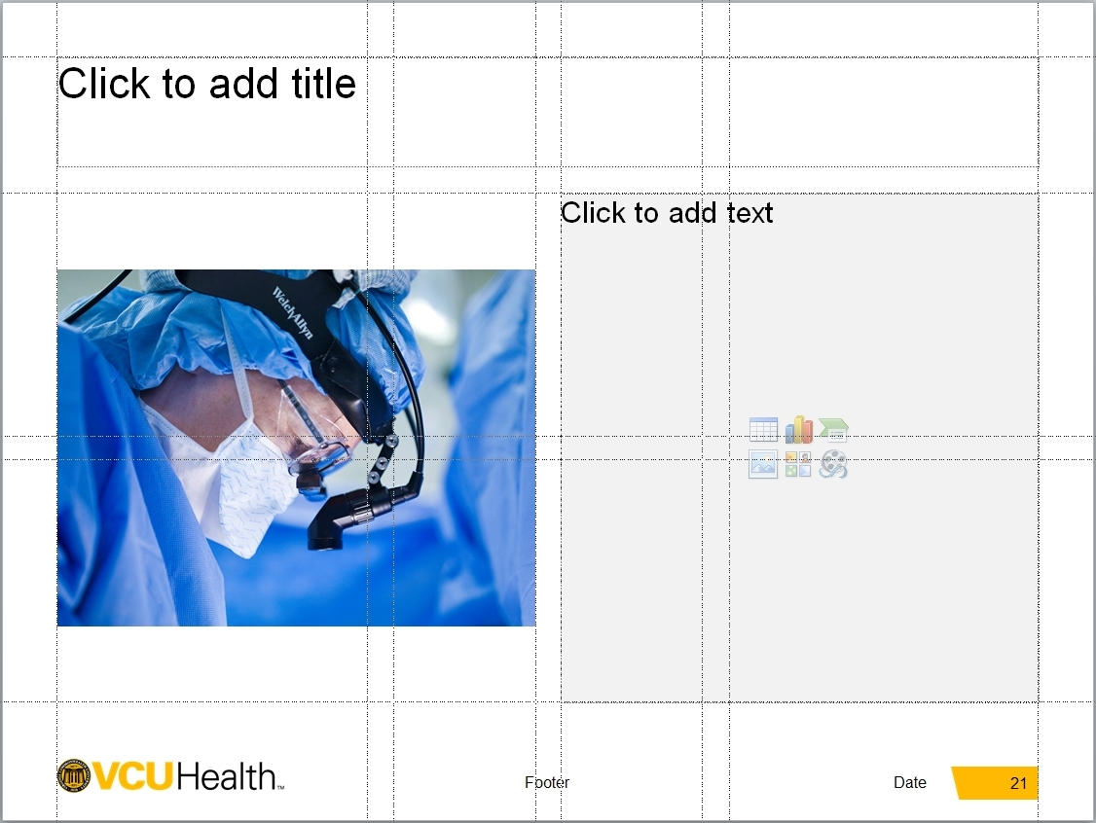
Scaling/Resizing Images
PowerPoint will automatically resize the content box to the image height or width
Shown on the left side of the slide is a inserted image now smaller than the original content box (on the right)

Slide 29
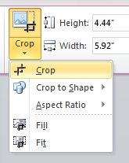
Scaling/Resizing Images
If you want the image to be the same size as the original content box:
Select the image
Format Tab > Crop
Choose the Crop tool from the drop down menu

Slide 30

Scaling/Resizing Images
Crop handles will appear on the box
Click and drag the box handles (bars) to match the original content box size (Aligned with the guides.)
In this example, the top middle handle was moved up and bottom middle down

Slide 31
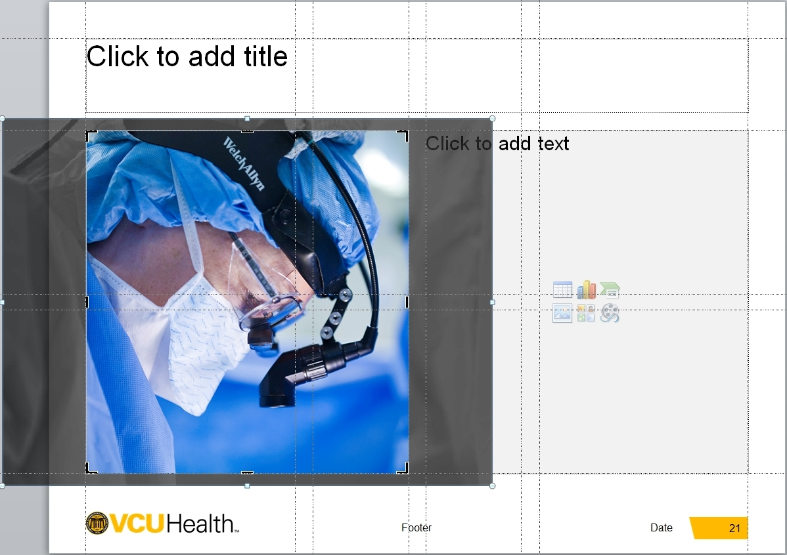
Scaling/Resizing Images
Scale the image by clicking and dragging the resize handles (circles)
Scale so that the image content extends past the content box edges
Be sure to hold down the Shift key to ensure the image maintains proportions

Slide 32
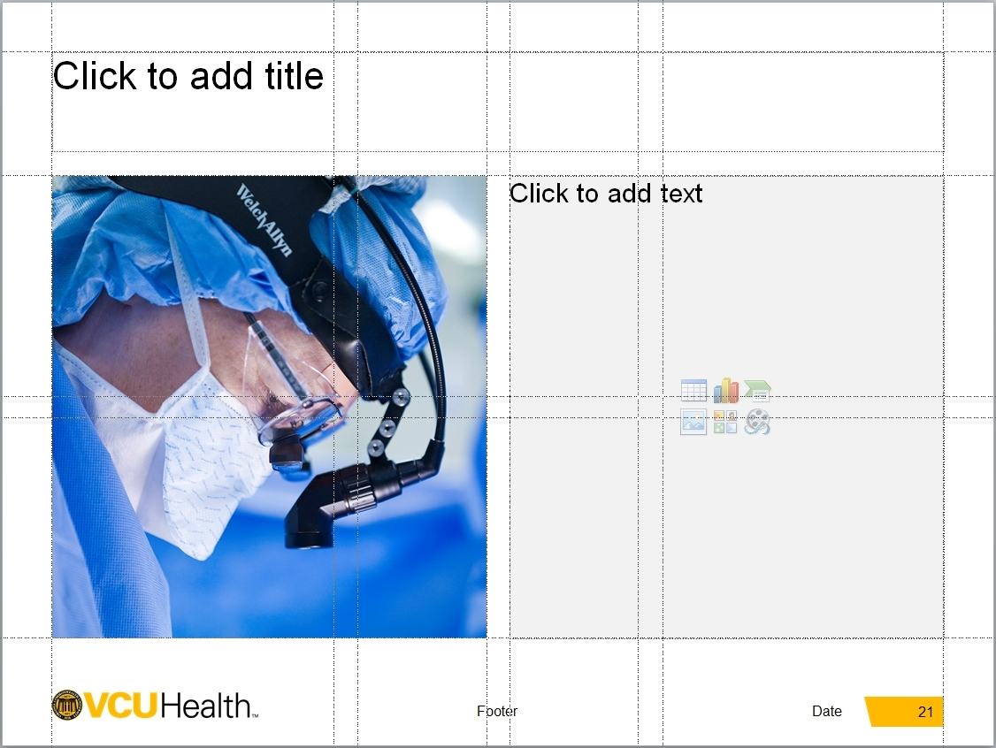
Scaling/Resizing Images
Click and drag the image content to reposition as desired
When satisfied, deselect the image
Final image is shown cropped and resized to the original content box size

Slide 33
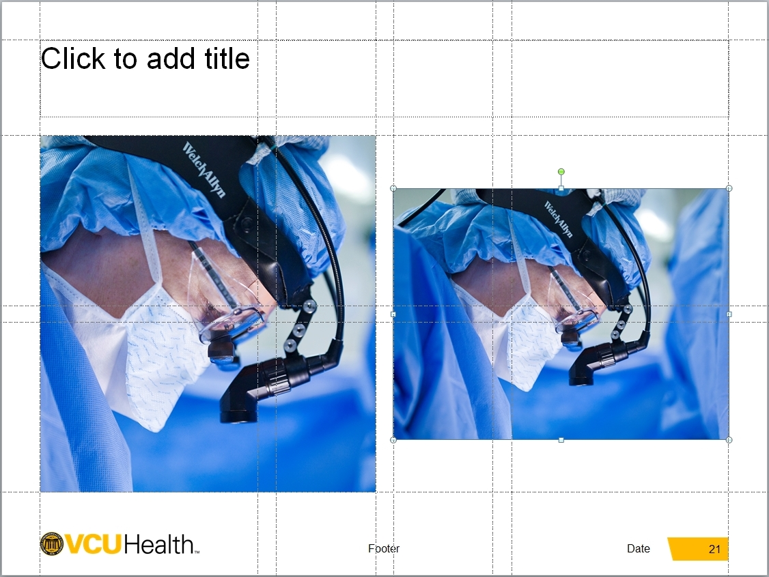
Scaling/Resizing Images
On the left: inserted image with resize and crop adjustments
On the right: inserted image without resize and crop adjustments

Slide 34


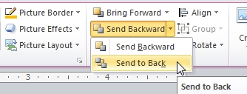
Sending image to back
Some slides contain graphic elements that appear above the placed image. After placing the image you need to send the image to the back for the slide to appear correct.
Place the image
Format > Send Backward > Send to Back

Slide 35
Charts
Click on the ‘Insert Chart’ icon of a content box to insert a chart.

Slide 36
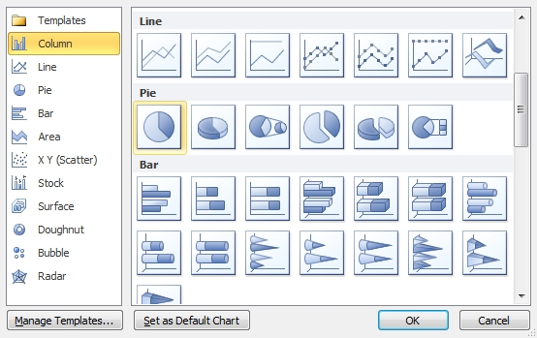
Charts
Choose the style of chart. Click ‘OK’.

Slide 37
Charts
A new sample chart will be inserted which you can customize.
The colors for charts are set to the corporate colors with VCU Health Gold, yellow and orange in order of priority followed by the dark support colors.
Charts should appear on a white background.

Slide 38
Tables
Click on the ‘Insert Table’ icon of a content box to insert a table.

Slide 39
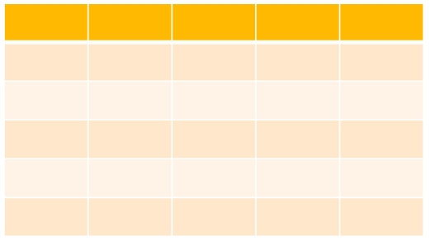
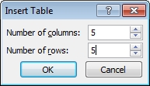
Tables
Specify the number of columns and rows
A sample table will be inserted using the VCU Health corporate colors

Slide 40
Reusing content from older documents
This template makes use of a grid system with content placeholder boxes provided in various configurations
As our older presentations are not setup with this grid, we discourage using the built-in feature of Powerpoint to import slides into our new template (Home Tab > New Slide > Reuse Slides…). Doing so will import new content boxes that do not align with the grid into your presentation.
An alternative is to copy the content of each box of the older slide into the new presentation

Slide 41

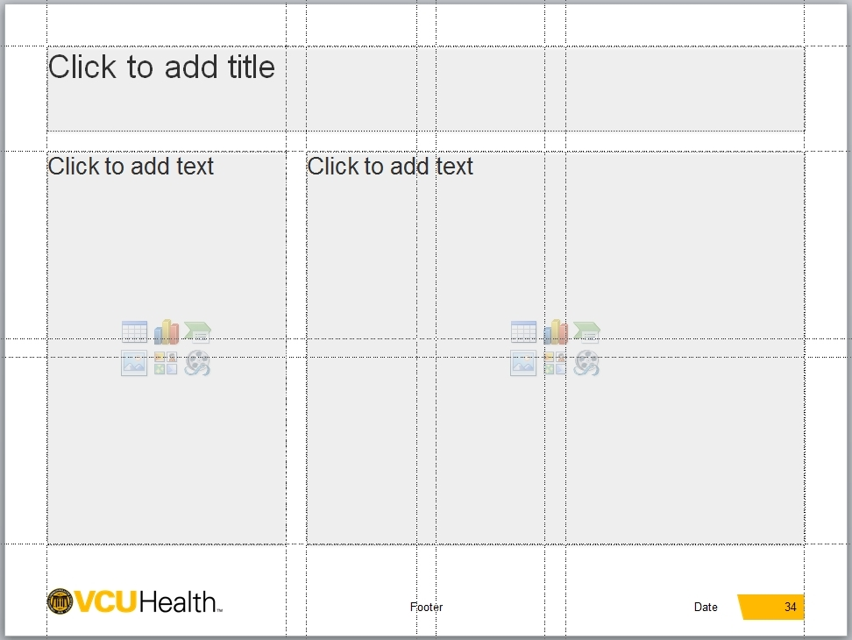
Reusing content from older documents
Shown on the top right is a slide from an older presentation.
Looking at the content, it is determined that it fits best into the ‘Second column wide’ template (shown at the bottom).
Insert a new slide using the ‘Second column wide’ layout.

Slide 42
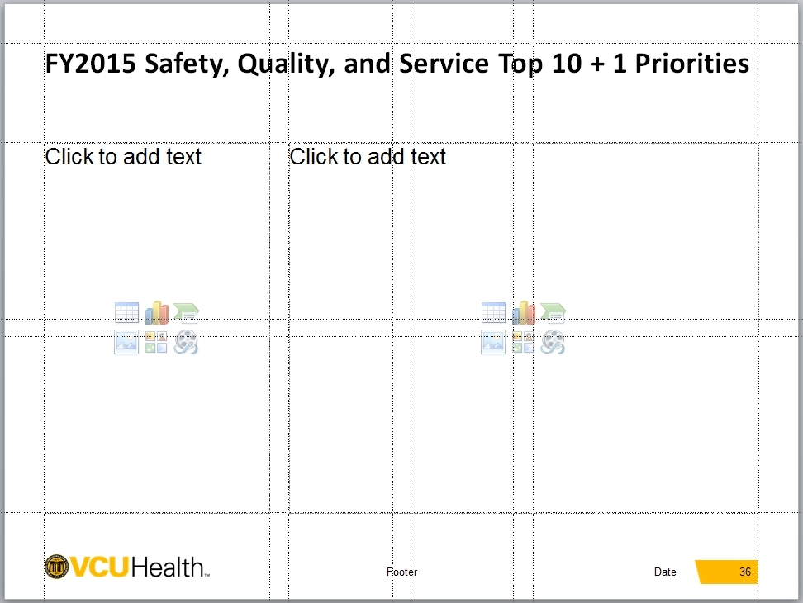
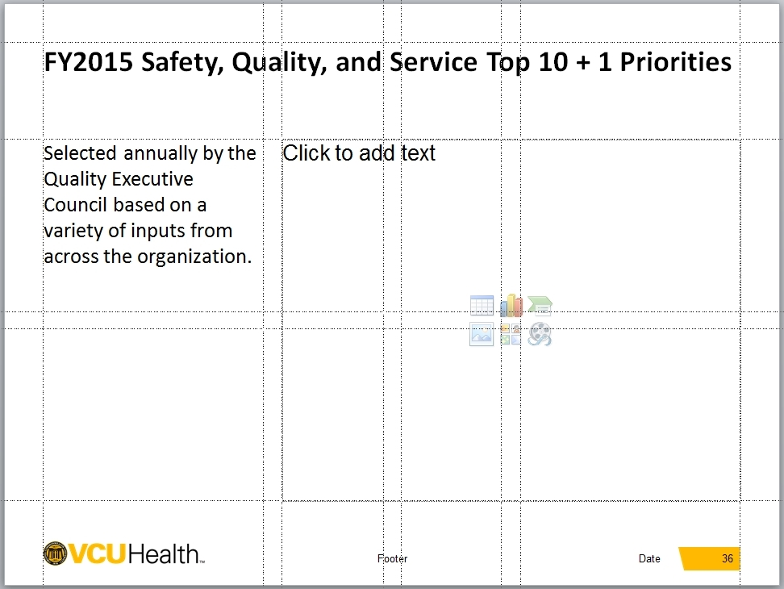
Reusing content from older documents
From the old presentation:
Select all the content from a content box
Switch to the new presentation and paste into the corresponding content box
Shown on top: the headline is pasted in
Shown on bottom: now the left column text is pasted in

Slide 43
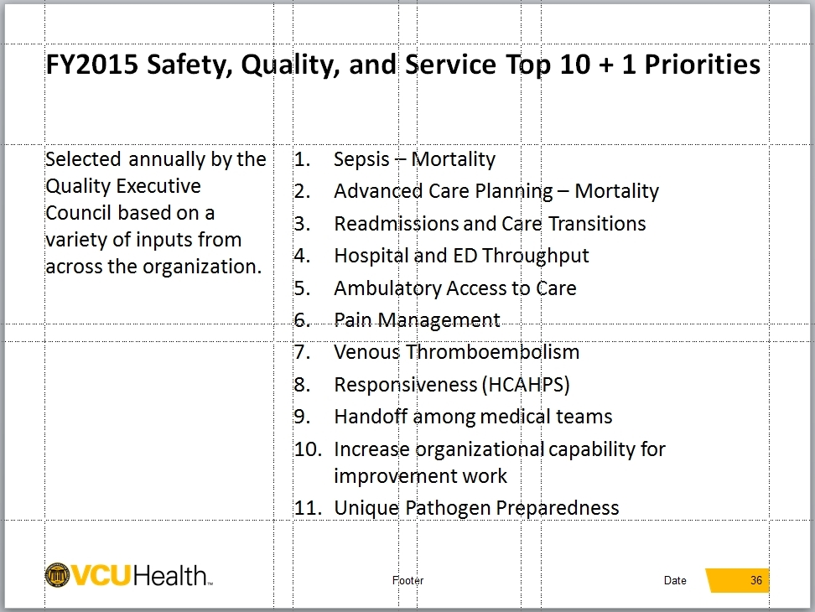
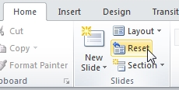
Reusing content from older documents
Continue switching between documents until all content from the old presentation is in the new presentation
In the new presentation:
Select the slide
Home Tab > Click ‘Reset’
This will reset the slide content to the default styles – clearing out any that came from the old document

Slide 44
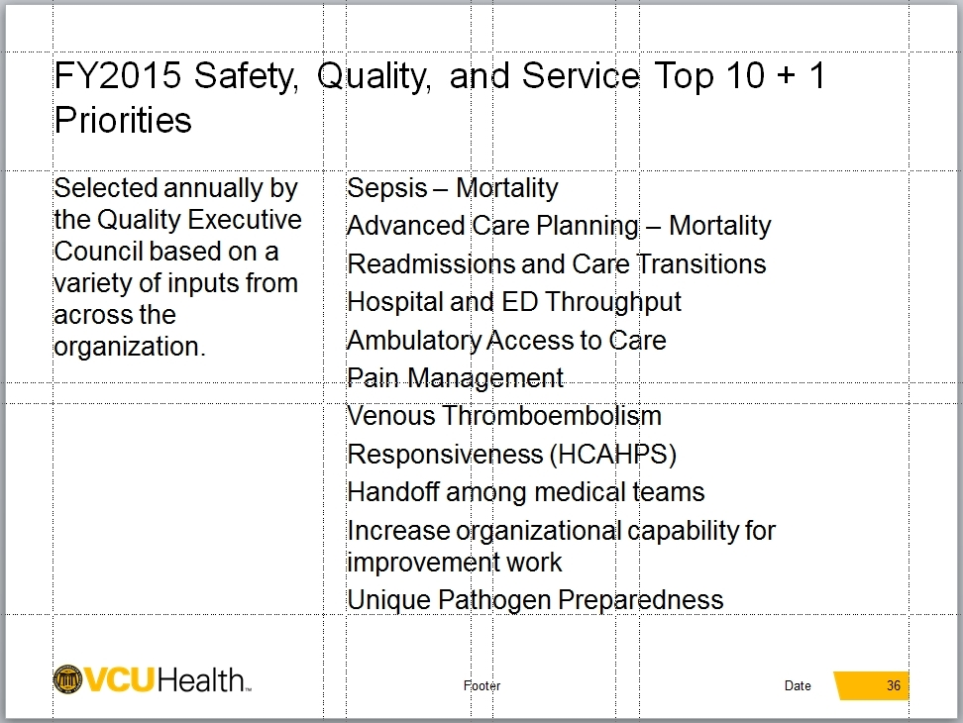
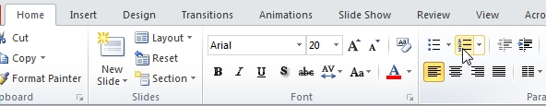
Reusing content from older documents
As you can see at the right top, the number bullets were lost when you reset the slide
To re-apply the number bullets:
Select all the text in the right column
Home Tab > Click ‘Numbering’

Slide 45
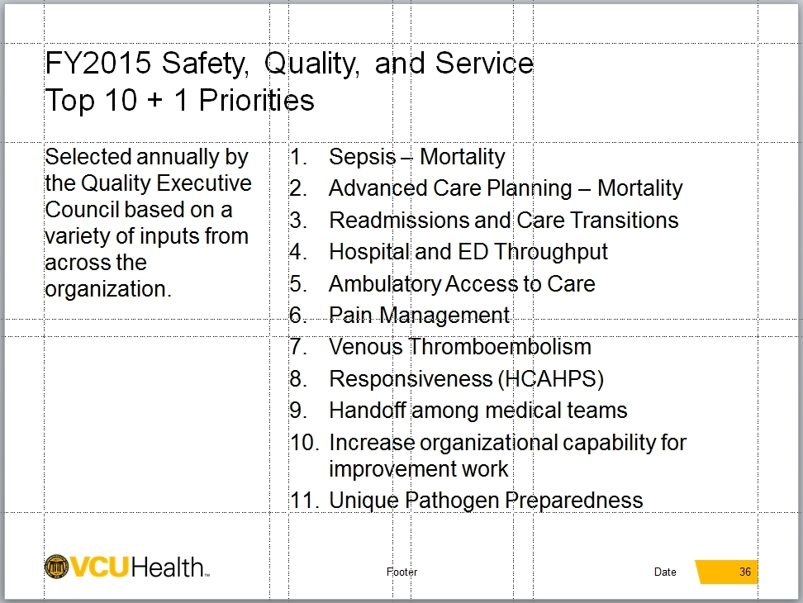
Reusing content from older documents
The number bullets appear again.
You may have to make small aesthetic revisions to finish the slide (in this example, placing a return after ‘Service’ in the headline)
Top: final slide in new presentation
Bottom: original slide in old presentation

Slide 46

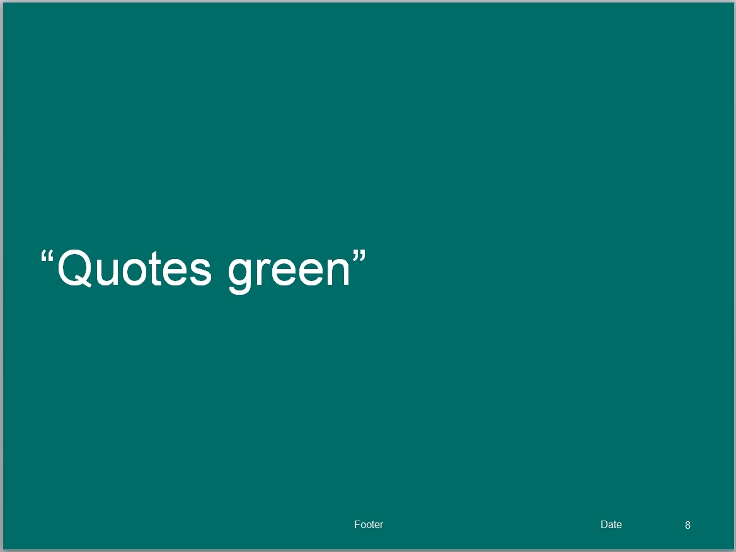
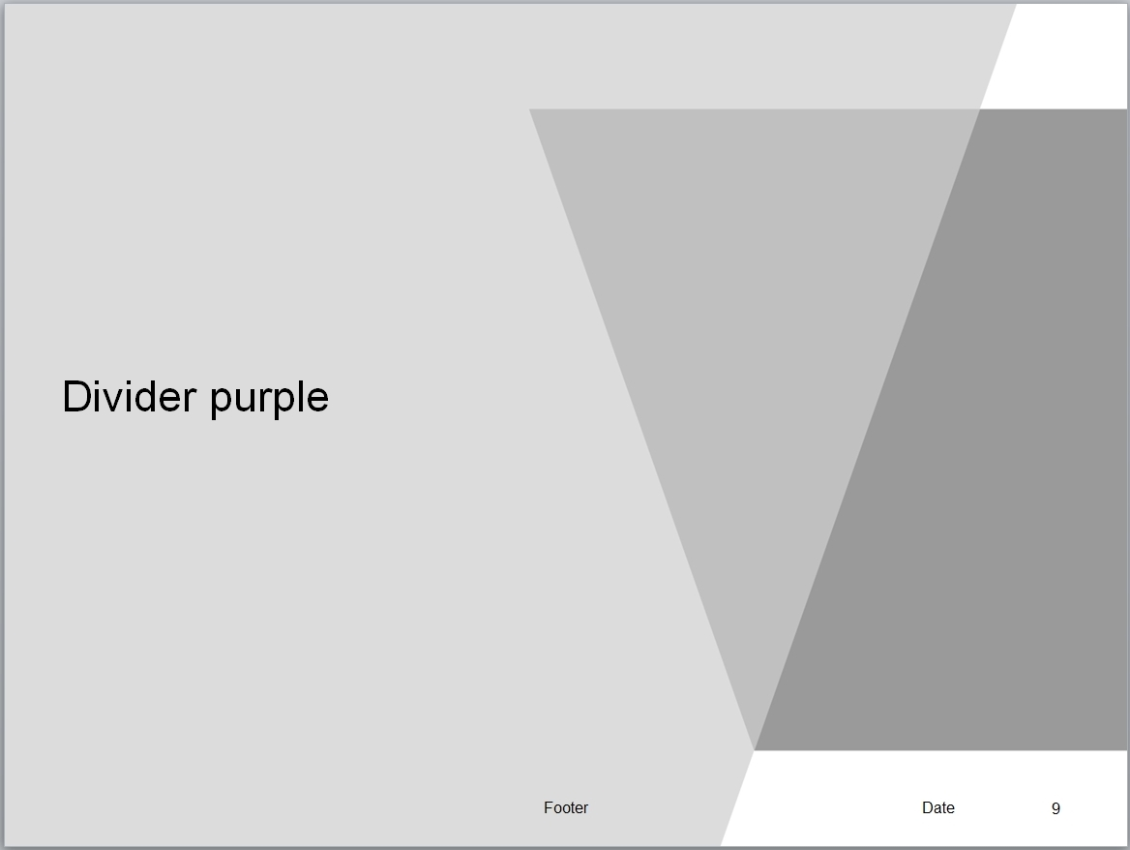
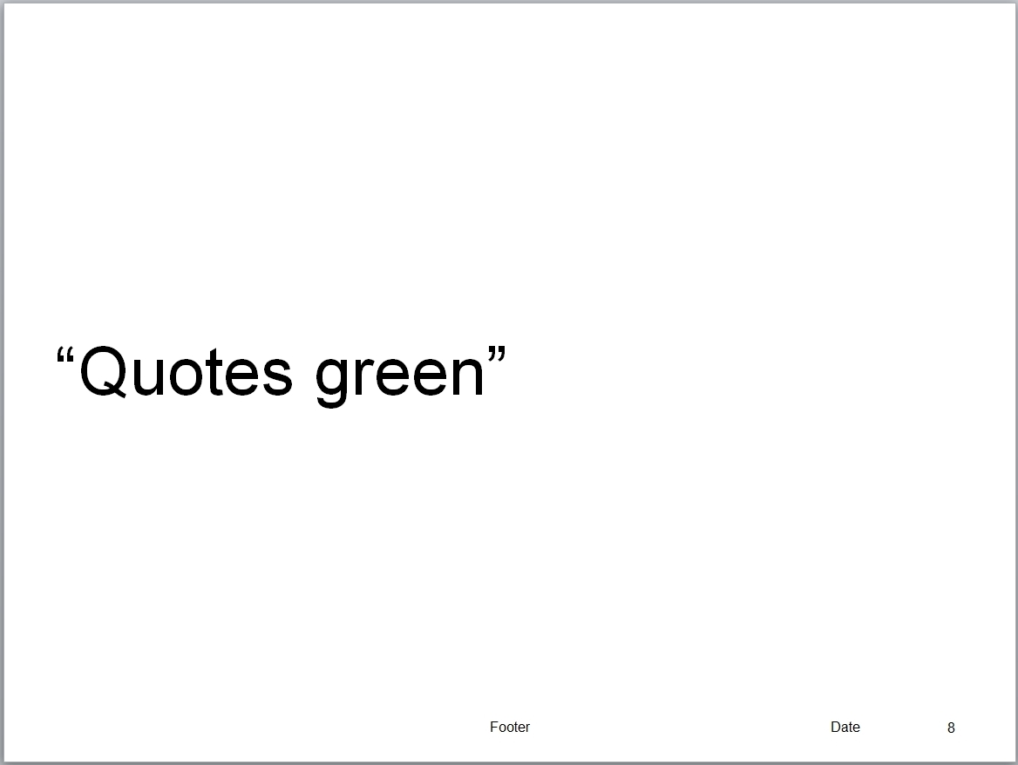
Printing in Grayscale or Black and White
Note: When printing to a black and printer, this template is configured to print using grayscale to reduce the amount of toner used.

